Slide 1
Lecture 7
The second law of thermodynamics.
Heat engines and refrigerators.
The Carnot cycle.
Entropy.

Slide 2
Irreversibility of processes
There exist many processes that are irreversible:
the net transfer of energy by heat is always from the warmer object to the cooler object, never from the cooler to the warmer
an oscillating pendulum eventually comes to rest because of collisions with air molecules and friction. The mechanical energy of the system converted to internal energy in the air, the pendulum, and the suspension; the reverse conversion of energy never occurs.

Slide 3
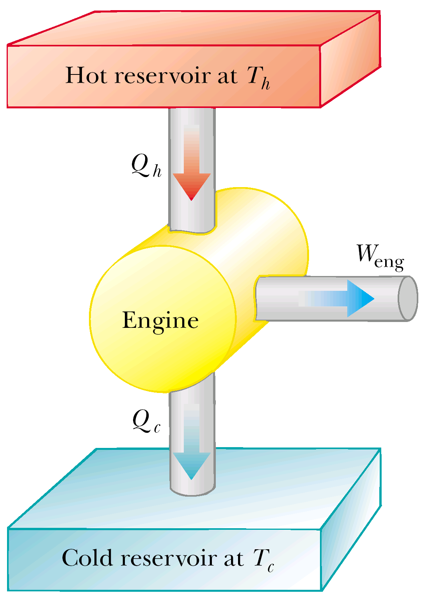
Heat Engines
A heat engine is a device that takes in energy by heat and, operating in a cyclic process, expels a fraction of that energy by means of work.
W_{eng} – work done by the heat engine
Q_{h} – heat, entering the engine.
Q_{c} - energy, leaving the engine.

Slide 4
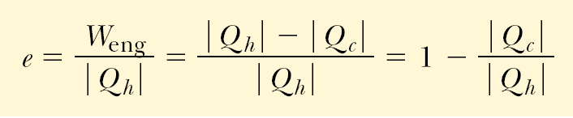
Thermal Efficiency of a Heat Engine
Good Automobile engine efficiency is about 20%
Diesel engine efficiency is about 35%-40%

Slide 5
Heat Pumps or Refrigerators
In a heat engine a fraction of heat from the hot reservoir is used to perform work.
In a refrigerator or a heat pump work is used to take heat from the cold reservoir and directed to the hot reservoir.

Slide 6
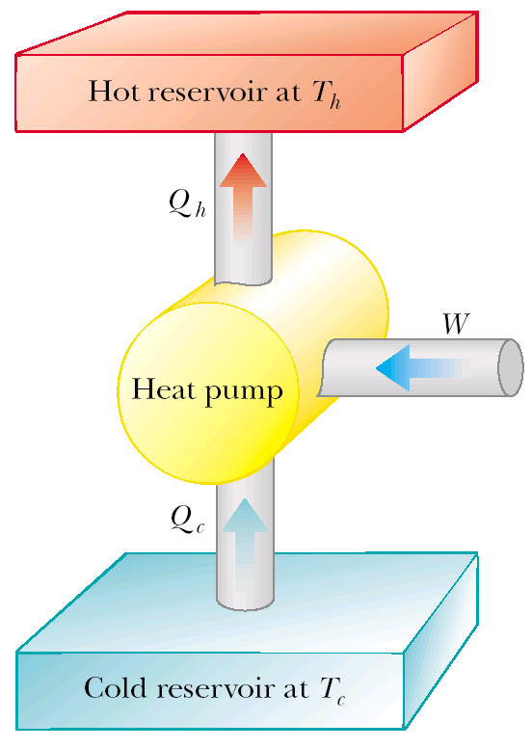
Refrigerator
W – work done on the heat pump
Q_{h} – heat, put into the hot reservoir.
Q_{c} - heat, taken from the cold reservoir.

Slide 7
Coefficient of performance of a refrigerator
The effectiveness of a refrigerator is described in terms of a number called the coefficient of performance (COP).
COP = Q_{c} /(Q_{h} - Q_{c}) = Q_{c} /W
Good refrigerate COP is about 5-6.

Slide 8
The Second Law of Thermodynamics
The Kelvin form:
It is impossible to construct a cyclic engine that converts thermal energy from a body into an equivalent amount of mechanical work without a further change in its surroundings.
Thus it says that for a heat engine it’s impossible for Q_{C}=0, or heat engine efficiency e=100%.

Slide 9
The Second Law of Thermodynamics
The Clausius form:
It is impossible to construct a cyclic engine which only effect is to transfer thermal energy from a colder body to a hotter body.
Thus for refrigerator it’s impossible that W=0, or COP = ∞.

Slide 10
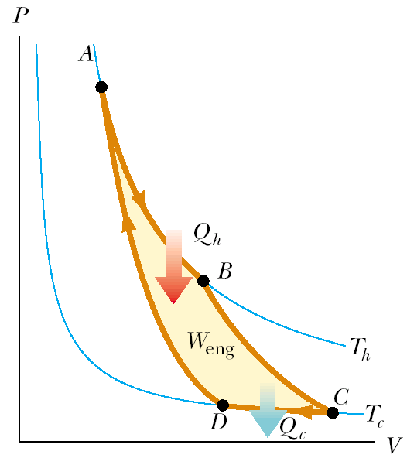
Carnot cycle
1. A-B isothermal expansion
B-C adiabatic expansion
3. C-D isothermal compression
4. D-A adiabatic compression

Slide 11
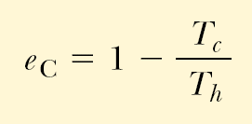
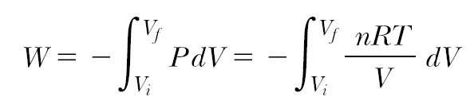
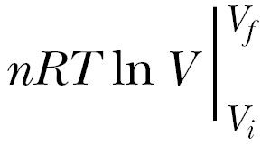

Carnot Efficiency
Using the equation of state and the first law of thermodynamics we can easily find that (look Servay p.678; Fishbane p.581):
Let’s prove it: During the isothermal expansion (process A → B), the work done by a gas during an isothermal process:

Slide 12
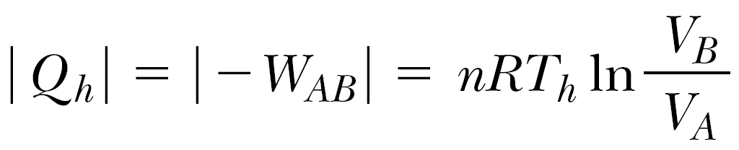
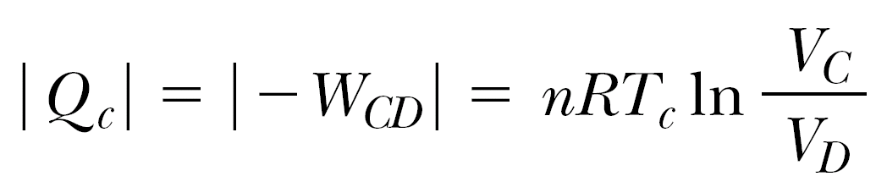
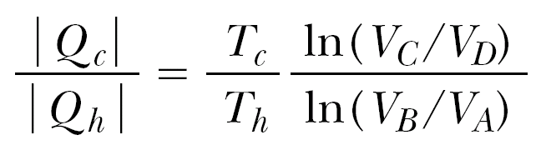
So, the work done on a gas during an isothermal process A → B is:
(1)
Similarly, for isothermal C → D:
(2)
Deviding (2) over (1):
(3)

Slide 13
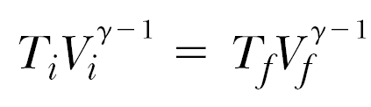
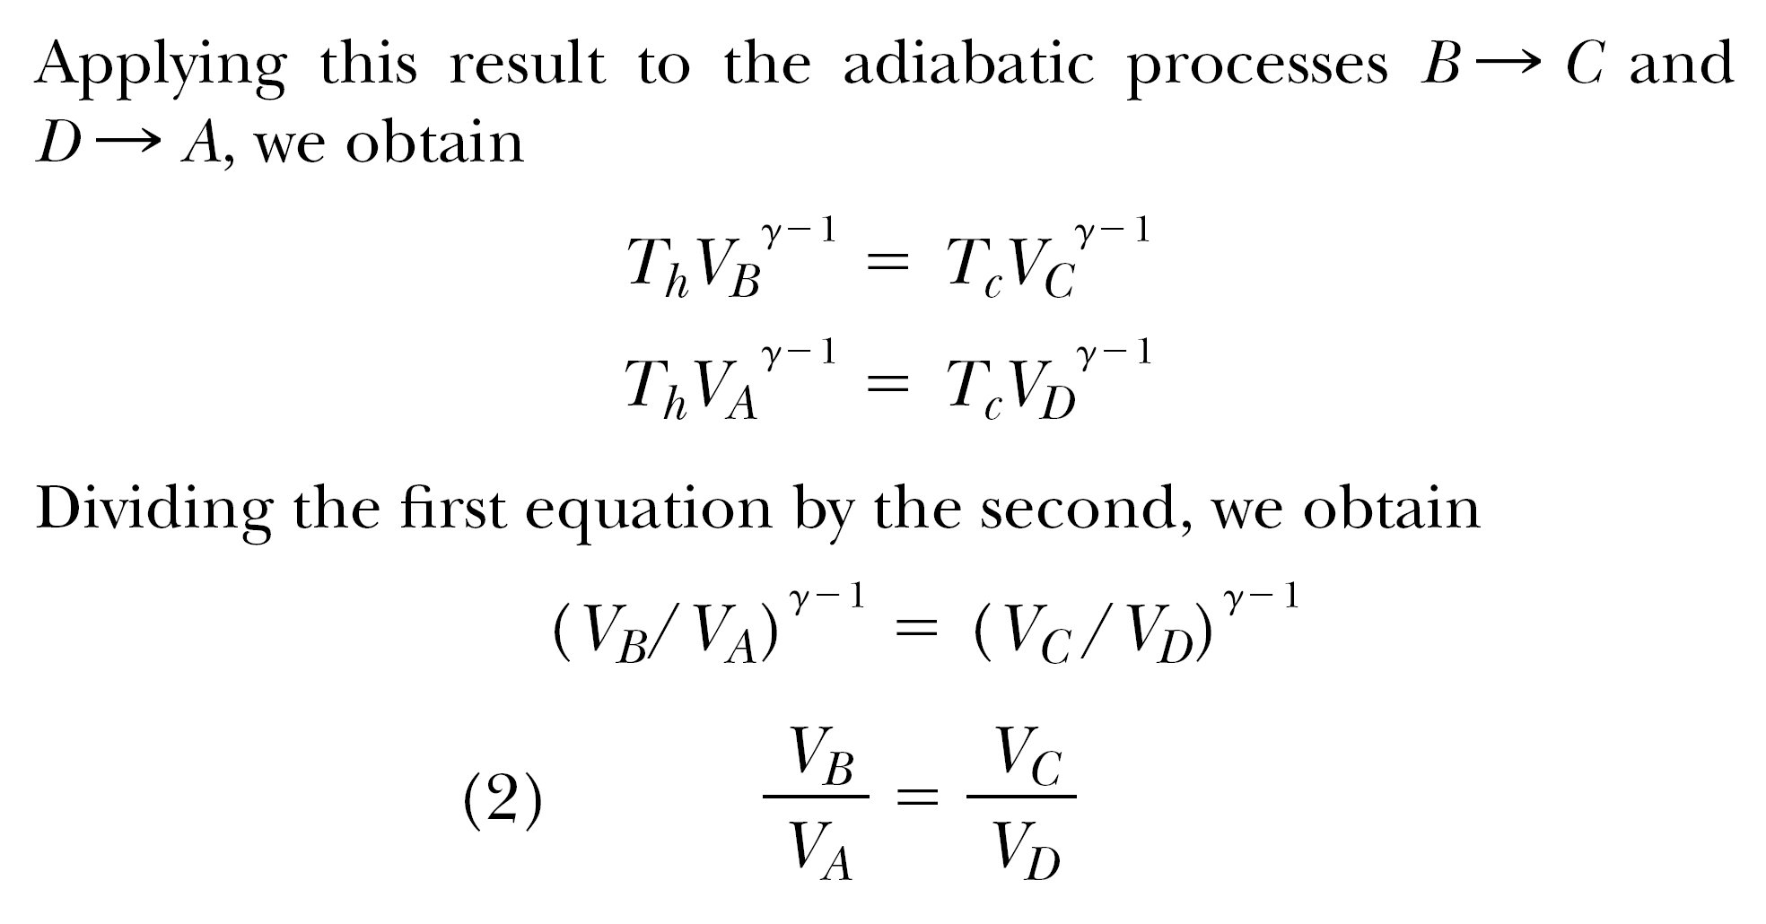

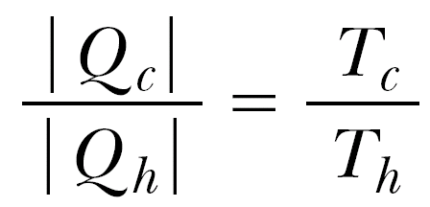
For adiabatic processes:
So, statement (3) gives us:

Slide 14
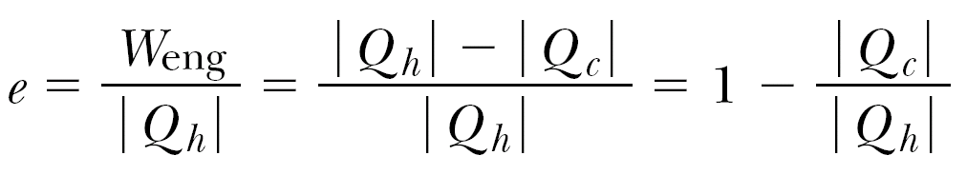
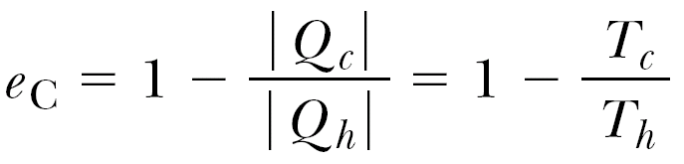
So, using the last expression and the expression for efficiency:
Thus we have proved that the Carnot Efficiency equals
Carnot Engine does not depend on the use of the ideal gas as a working substance.
Carnot Engine is Reversible – it can be used as a refrigerator or heat pump.
Carnot Cycle is the most efficient cycle for given two temperatures T_{h} and T_{c}.

Slide 15
Carnot theorem
The Carnot engine is the most efficient engine possible that operates between any two given temperatures.
(look Servay p.675; Fishbane p.584)

Slide 16
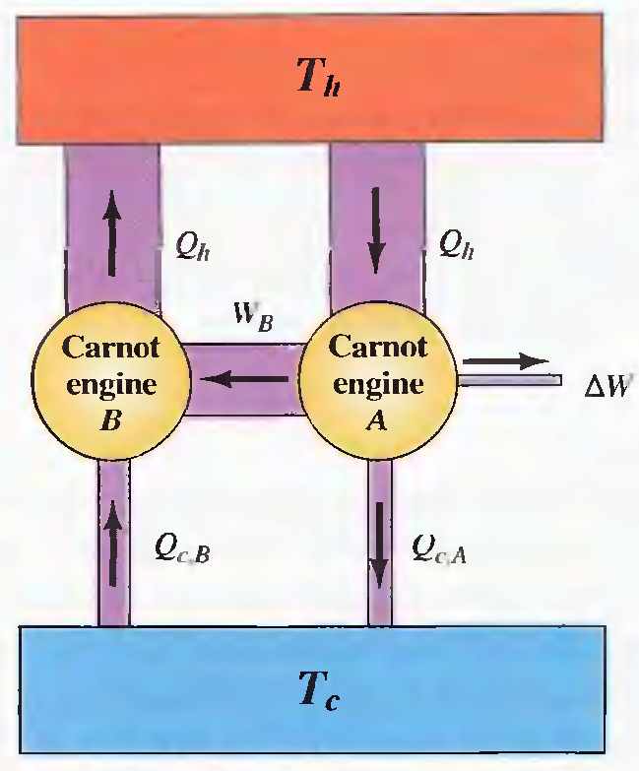
Carnot Theorem Proof
Let’s prove it from the contrary: let’s have Carnot engine A to be more efficient than Carnot engine B, they run together, engine B is operating in reverse. We adjust A to take Q_{h} and B to give the same
Q_{h} to the hot reservoir T_{h}. Thus we get Q_{cB} – Q_{cA}=ΔW. It means that we take energy from cold reservoir to produce work ΔW. But it violates the second law of thermodynamics.

Slide 17
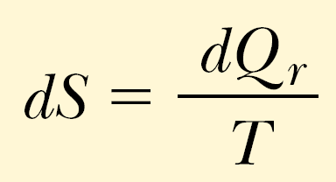
Entropy
Measures the amount of disorder in thermal system.
It is a function of state, and only changes in entropy have physical significance.
Entropy changes are path independent.
Another statement of the Second Law of Thermodynamics: The total entropy of an isolated system that undergoes a change cannot decrease.
For infinitesimal changes:

Slide 18
Entropy change calculations
Entropy is a state variable, the change in entropy during a process depends only on the end points and therefore is independent of the actual path followed. Consequently the entropy change for an irreversible process can be determined by calculating the entropy change for a reversible process that connects the same initial and final states.

Slide 19
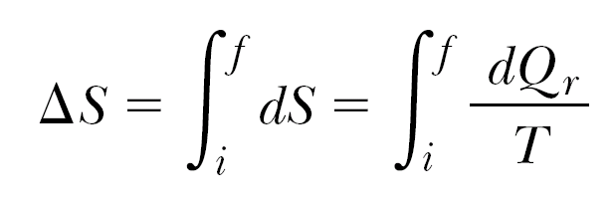
So for infinitesimal changes:
The subscript r on the quantity dQ_{r} means that the transferred energy is to be measured along a reversible path, even though the system may actually have followed some irreversible path. When energy is absorbed by the system, dQ_{r} is positive and the entropy of the system increases. When energy is expelled by the system, dQ_{r} is negative and the entropy of the system decreases.
Thus, it’s possible to choose a particular reversible path over which to evaluate the entropy in place of the actual path, as long as the initial and final states are the same for both paths.

Slide 20
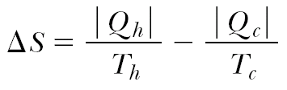
Change of Entropy in a Carnot Cycle
Carnot engine operates between the temperatures T_{c} and T_{h}. In one cycle, the engine takes in energy Q_{h} from the hot reservoir and expels energy Q_{c} to the cold reservoir. These energy transfers occur only during the isothermal portions of the Carnot cycle thus the constant temperature can be brought out in front of the integral sign in expression
Thus, the total change in entropy for one cycle is

Slide 21
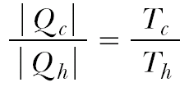
Reversibility of Carno Cycle
Using equality, proved for the Carnot Cycle (slide N13):
We eventually find that in Carno Cycle:
ΔS=0

Slide 22
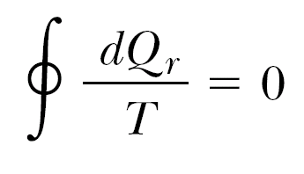

Reversible Cycle
Now consider a system taken through an arbitrary (non-Carnot) reversible cycle. Because entropy is a state variable —and hence depends only on the properties of a given equilibrium state —we conclude that
ΔS=0
for any reversible cycle. In general, we can write this condition in the mathematical form
the symbol indicates that the integration is over a closed path.

Slide 23
Ideal Gas Reversible Process
Suppose that an ideal gas undergoes a quasi-static, reversible process from an initial state T_{i}, V_{i} to a final state T_{f}, V_{f} .
1st law of thermodynamics: dQ_{r} = ΔU + W,
Work: W=pdV,
Internal Energy change: ΔU=nC_{v}dT, (n – moles number)
Equation of state for an Ideal Gas: P=nRT/V,
Thus: dQ_{r} = nC_{v}dT + nRTdV/V
Then, dividing the last equation by T, and integrating we get the next formula:

Slide 24

- This expression demonstrates that ΔS depends only on the initial and final states and is independent of the path between the states. The only claim is for the path to be reversible.
- ΔS can be positive or negative
- For a cyclic process (T_{i}= T_{f}, V_{i} = V_{f}), ΔS=0. This is further evidence that entropy is a state variable.

Slide 25
The Second Law of Thermodynamics
The total entropy of an isolated system that undergoes a change cannot decrease.
If the process is irreversible, then the total entropy of an isolated system always increases. In a reversible process, the total entropy of an isolated system remains constant.

Slide 26
Microscopic States
Every macrostate can be realized by a number of microstates.
Each molecule occupies some microscopic volume V_{m}. The total number of possible locations of a single molecule in a macroscopic volume V is the ratio
w =V/V_{m}.
Number w represents the number of ways that the molecule can be placed in the volume, or the number of microstates, which is equivalent to the number of available locations.
If there are N molecules in volume V, then there are
W = w^{N} = (V /V_{m})^{N}
microstates, corresponding to N molecules in volume V.

Slide 27
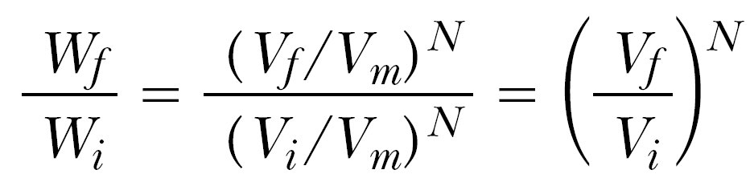
Entropy on a Microscopic Scale
Let’s have an ideal gas expanding from V_{i} to V_{f}. Then the numbers of microscopic states are:
For initial state: W_{i} = w_{i}^{N} = (V_{i} /V_{m})^{N} .
For final state: W_{f} = w_{f}^{N} = (V_{f} /V_{m})^{N} .
Now let’s find their ratio:
So we canceled unknown V_{m}.

Slide 28
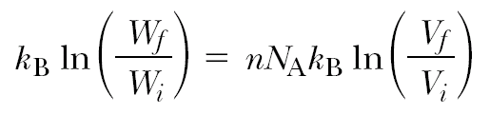
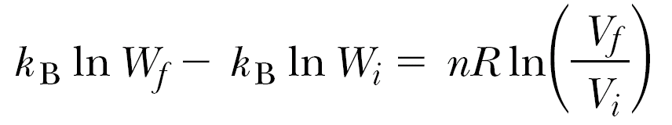
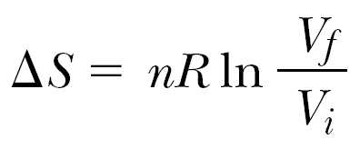
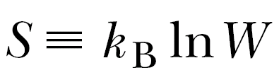
After further transformations:
n – number of moles, R=k_{b}Na.
Then we use the equation for isothermal expansion (look Servay, p.688):
Using the expression from the previous slide
we get:

Slide 29
Entropy is a measure of Disorder
The more microstates there are that correspond to a given macrostate, the greater is the entropy of that macrostate.
Thus, this equation indicates mathematically that entropy is a measur measure of disorder. Although in our discussion we used the specific example of the free expansion of an ideal gas, a more rigorous development of the statistical interpretation of entropy would lead us to the same conclusion.

Slide 30
Independent Study
Reynold’s number, Poiseuille flow, viscosity, turbulence (Fishbane p.481, Lecture on physics Summary by Umarov).
Entropy Change in a Free Expansion. (Servay p.688).
Entropy Change in Calorimetric Processes (Servay p.689)

